Slide 1

Agent Compliance Center
Team : Ravikiran, Sonali, Puja, Vasavi

Slide 2




Meet the Team
Ravikiran Patil
Sonali Panda
Vasavi Bhaviri Setty
Pujarini Mohapatra

Slide 3
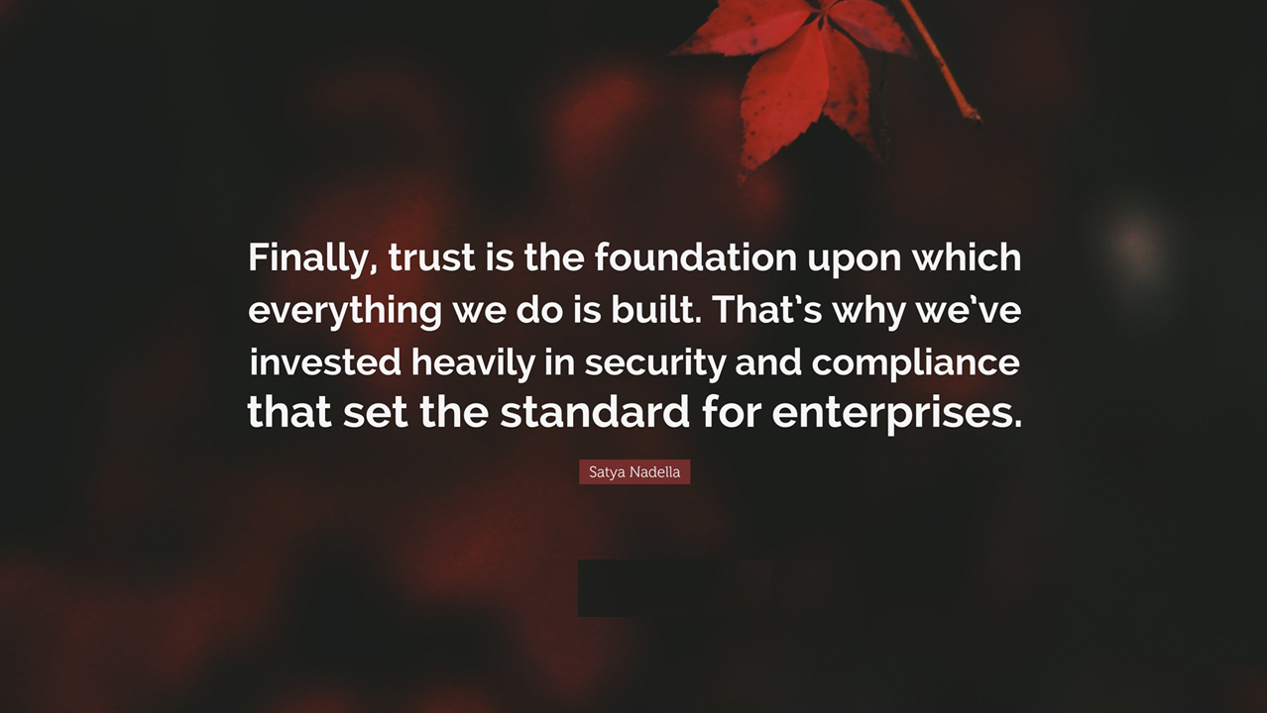

Slide 4

Growing privacy and data concerns with Agents
Is there a way to track conversations and identify sensitive data to block
Are agents handling sensitive data appropriately?
How can I ensure data privacy regulations are enforced on my agents
Is PII data being exposed to admins
Notes:
Who is asking for this?
Who benefits with this?

Slide 5
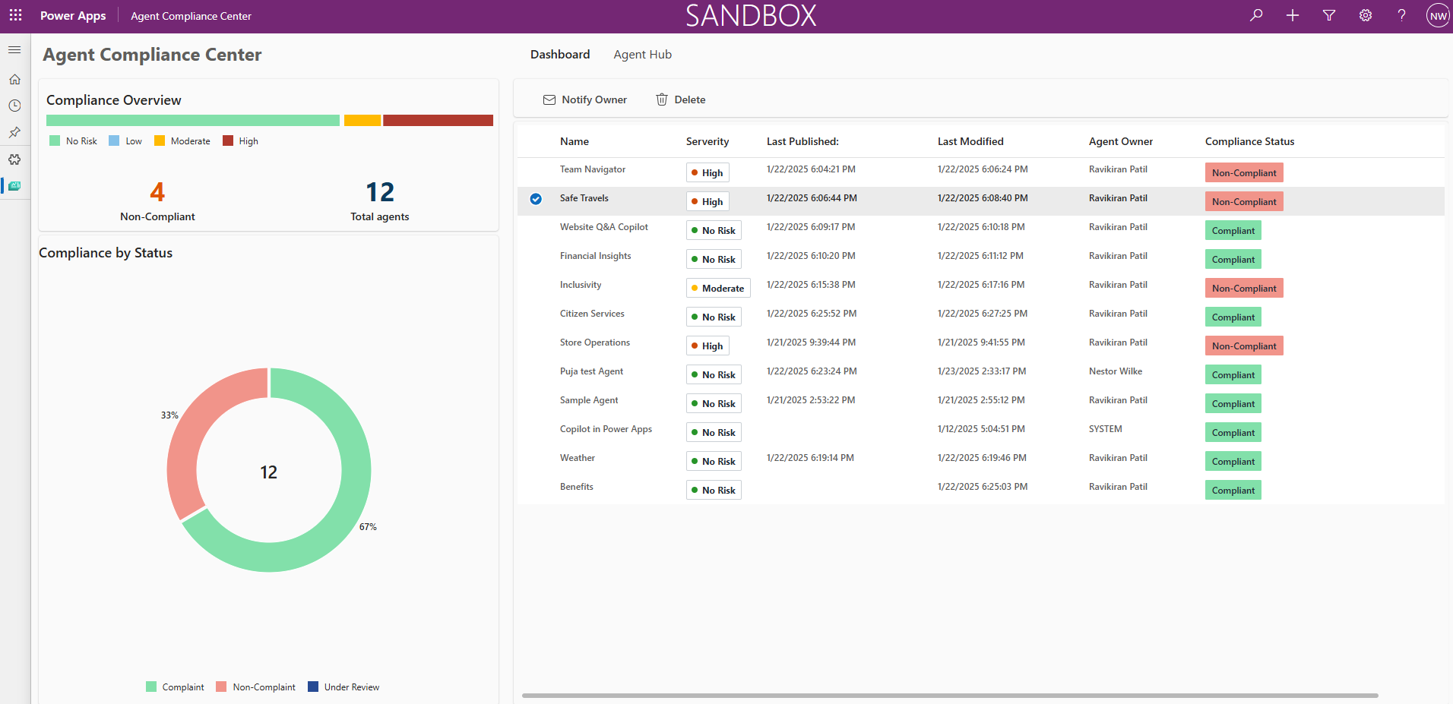
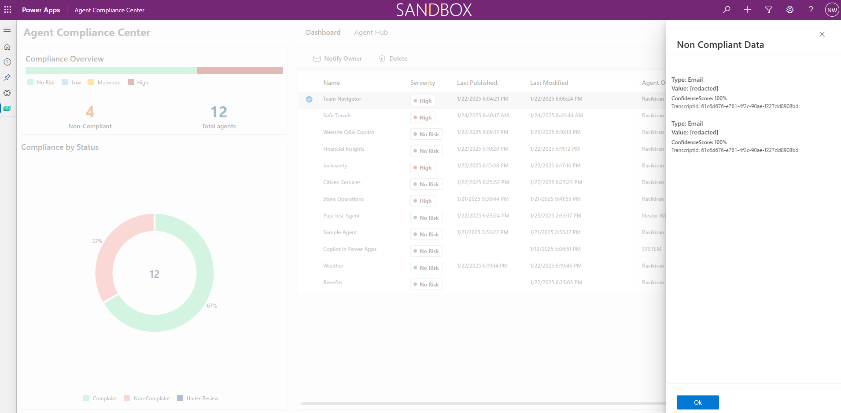
AGENT COMPLIANCE DASHBOARD
Ensures compliance with data privacy regulations.
A centralized tool for Copilot Studio Admins to monitor and manage the use of Personally Identifiable Information (PII) and sensitive data within conversation histories.
It helps to detect, review, and take corrective actions on non-compliant data usage
Reduces the risk of privacy breaches and regulatory violations.

Slide 6
WHAT DOES IT OFFER?
CENTRALIZED COMPLIANCE MONITORING
Provides a unified view of all agents and conversations, simplifying the process of identifying non-compliance.
PII AND SENSITIVE DATA DETECTION
Automatically detects and highlights sensitive information, reducing manual effort and the risk of oversight.
ACTIONABLE INSIGHTS
Offers recommendations and tools for quick resolution of compliance issues, enhancing response times and effectiveness.
REGULATORY READINESS
Helps ensure adherence to global data privacy standards, minimizing legal and financial risks.
IMPROVED GOVERNANCE
Strengthens data governance practices with comprehensive tracking and reporting.

Slide 7



Business Value
Detect: Reduces the risk of data breaches and regulatory violations by providing proactive monitoring and management of sensitive information.
Protect: Helps organizations meet data protection standards, avoid fines and legal consequences, and maintain customer trust.
Respond: Streamlines compliance management with centralized visibility and actionable insights, reducing manual effort and enabling quicker resolution of non-compliant cases.

Slide 8
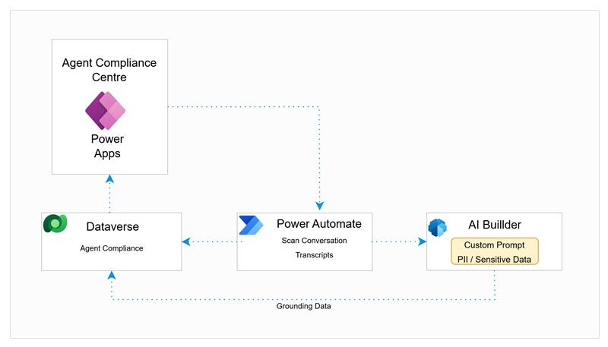
Architecture

Slide 9

Demo

Slide 10
NEXT STEPS
Plan for eventual inclusion in the product.
Integrate into the Copilot Studio kit.

